Slide 1
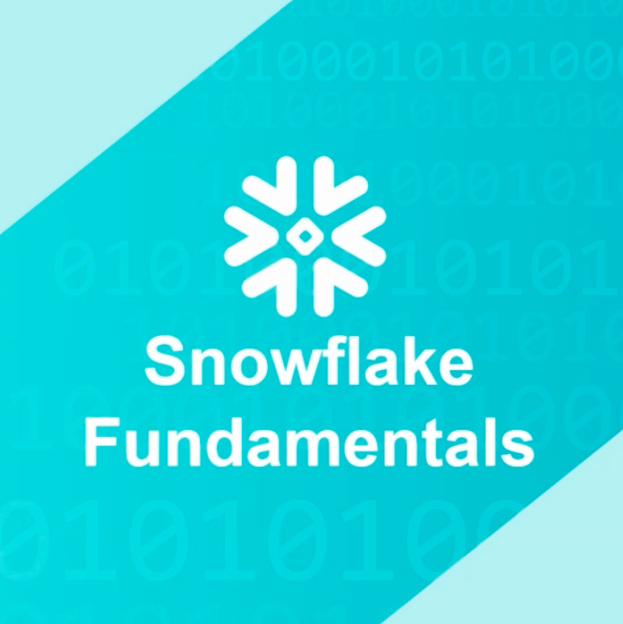
SNOWFLAKE
THE CLOUD DATA
PLATFORM

Slide 2
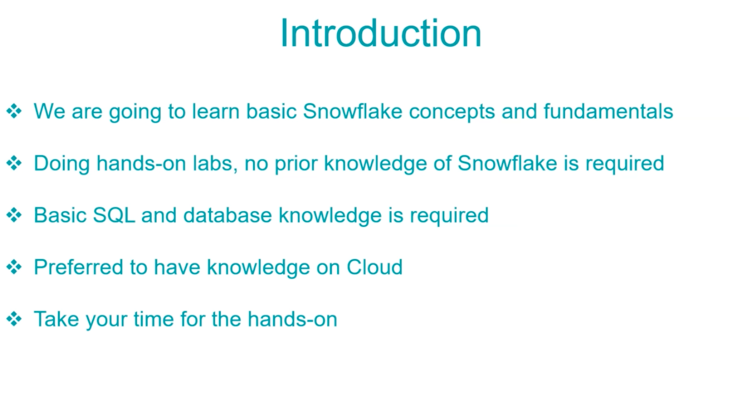
Introduction

Slide 3
What is Snowflake ?
Snowflake is an analytic data warehouse provided as Software-as- Services(SaaS). Snowflake provides data warehouse that is faster, easierto use and more flexible that other traditional data warehouses.
Snowflake data warehouse is not built on existing databases or not on big data software platform as Hadoop.
The snowflake data warehouse uses a new SQL database engine with unique architecture designed for the cloud.

Slide 4
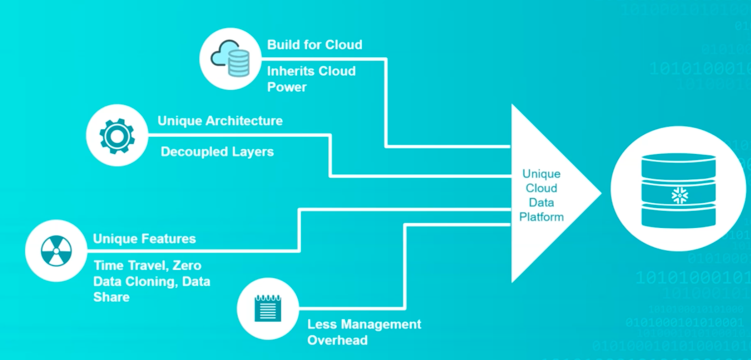
Snowflake Key Differentiator

Slide 5
Key Concept and Architecture
Data Warehouse as Cloud Service:
Snowflake data warehouse is true SaaS offering :
• There is no hardware (virtual or physical) for you to select, install, configure and manage.
• There is no software for you install, configure and manage.
• Ongoing maintenance, management and tuning is handled by snowflake.
Snowflake completely runs on cloud infrastructure. All the component of the snowflake service runs on public cloud infrastructure.
Snowflake uses virtual compute instance for its compute need and storage service for storage of data. Snowflake can not be run on private cloud infrastructure(on primises)

Slide 6
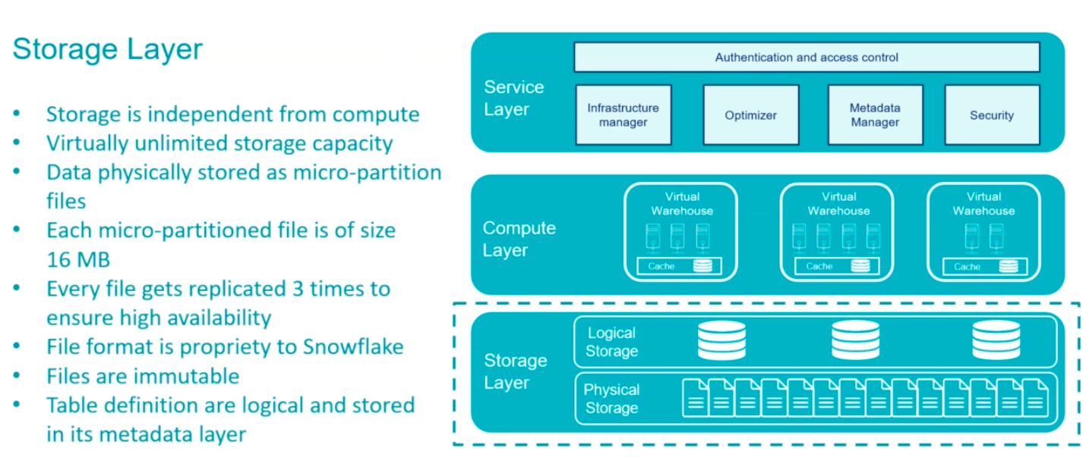
Snowflake Architecture

Slide 7
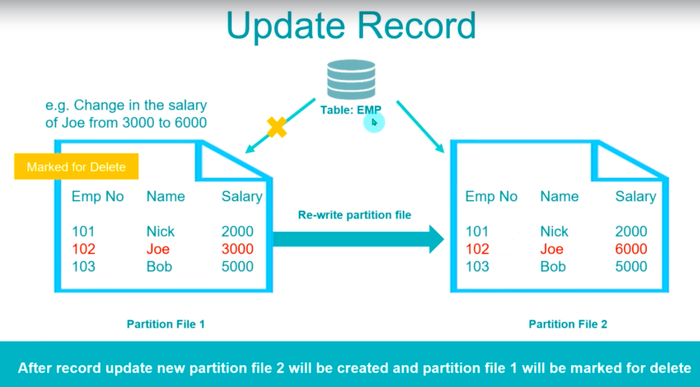
Update Record

Slide 8
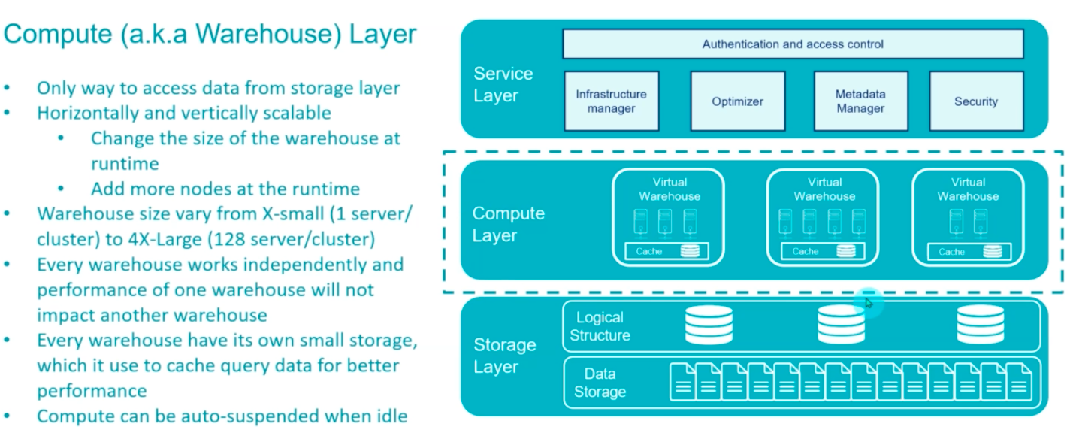
Compute Layer

Slide 9
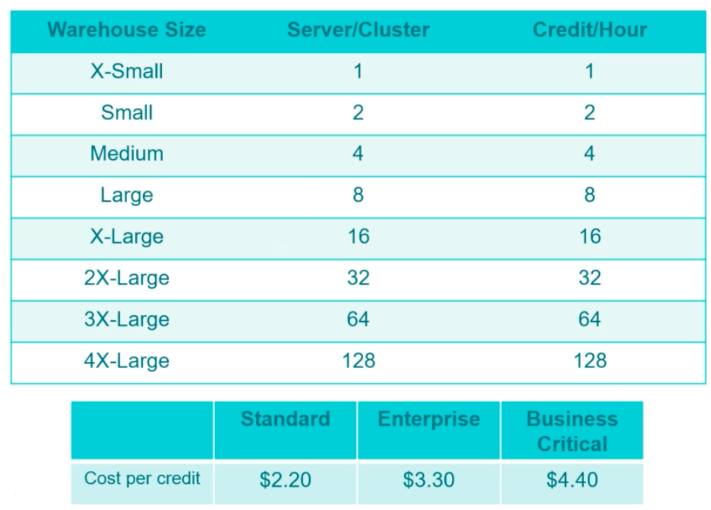
Warehouse Size & Pricing

Slide 10
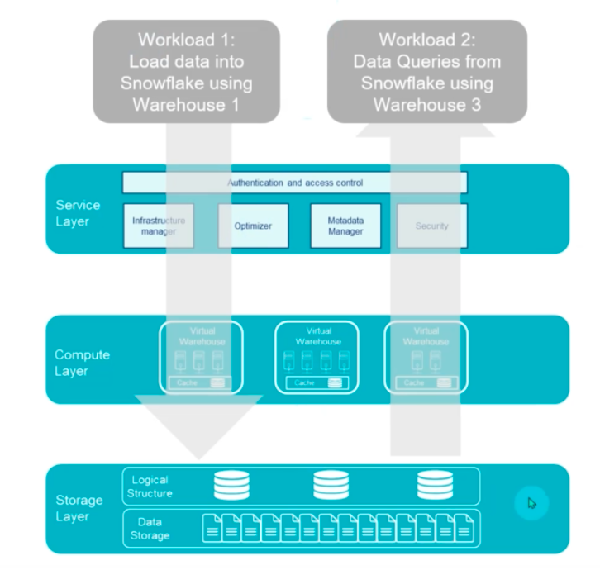
Separate Warehouse for Different Workloads

Slide 11
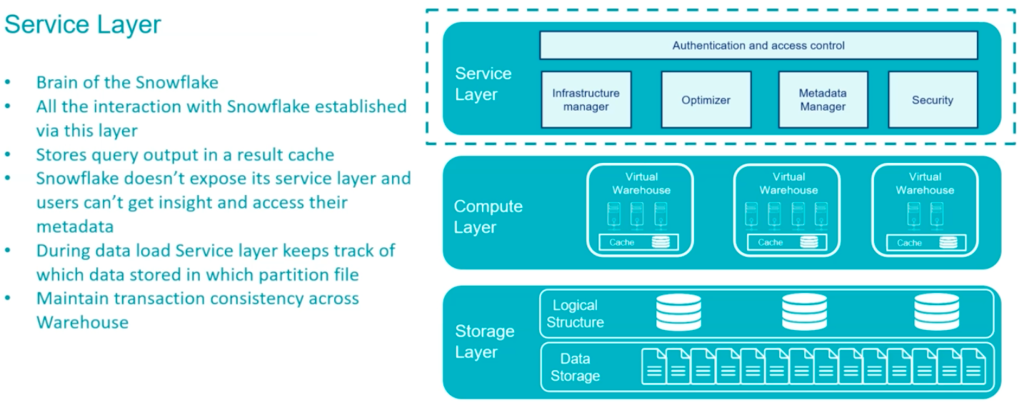
Service Layer

Slide 12
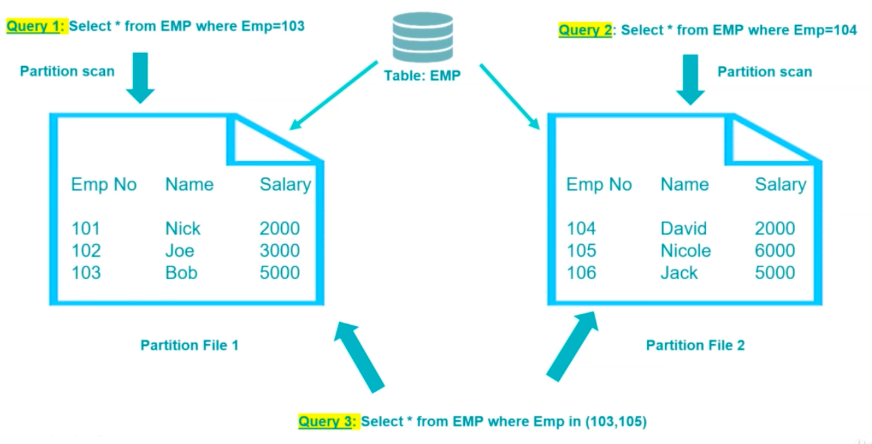
Table and Partition File Mapping

Slide 13
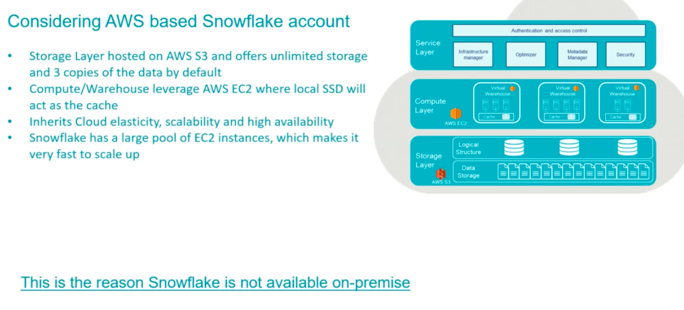
Why Only For Cloud(SaaS) ?

Slide 14
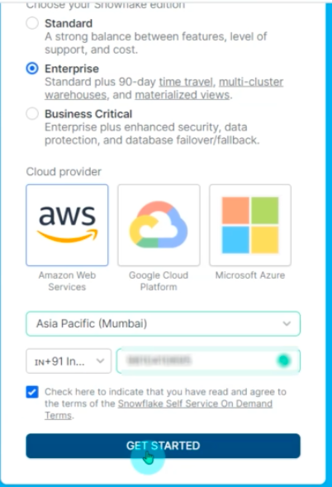
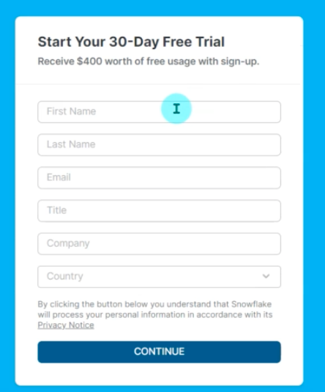
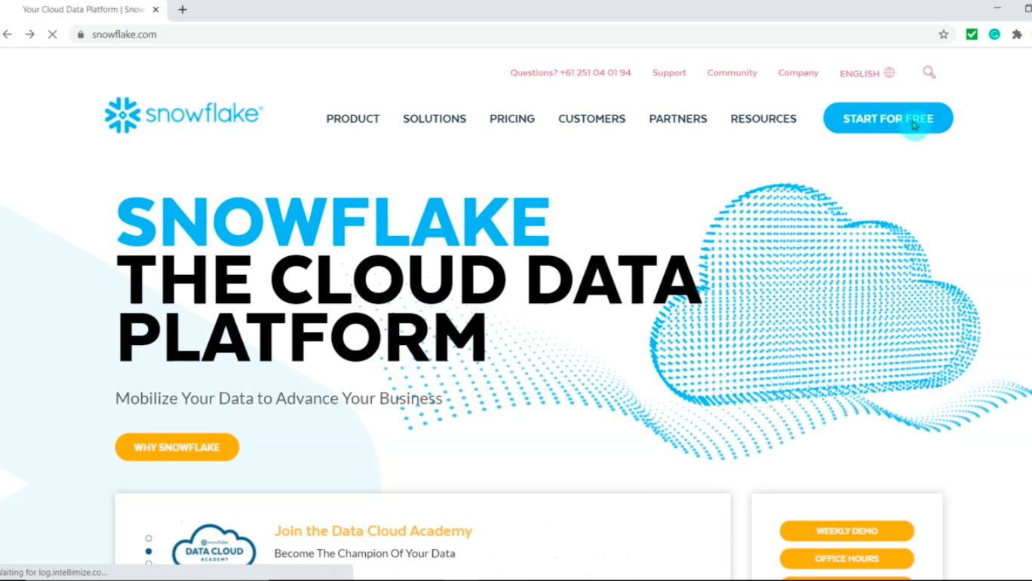
CREATE YOUR SNOWFLAKE ACCOUNT : SIGNUP

Slide 15
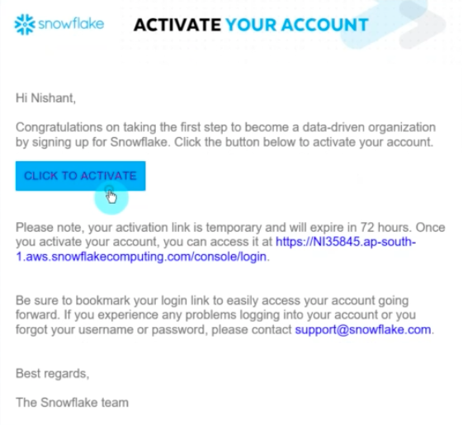
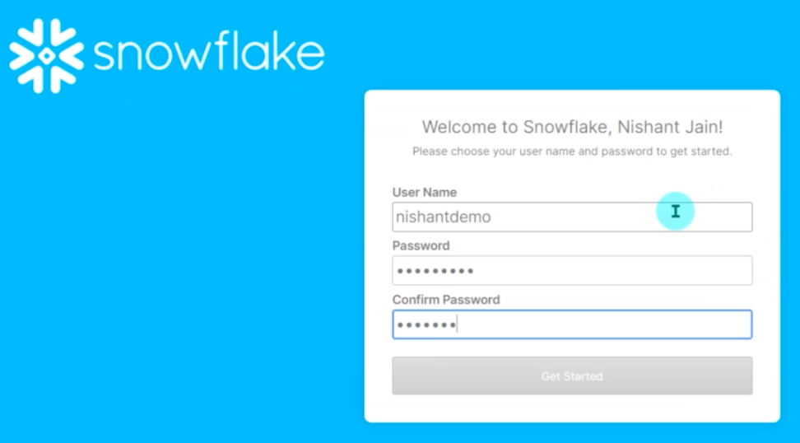
GET STARTED

Slide 16
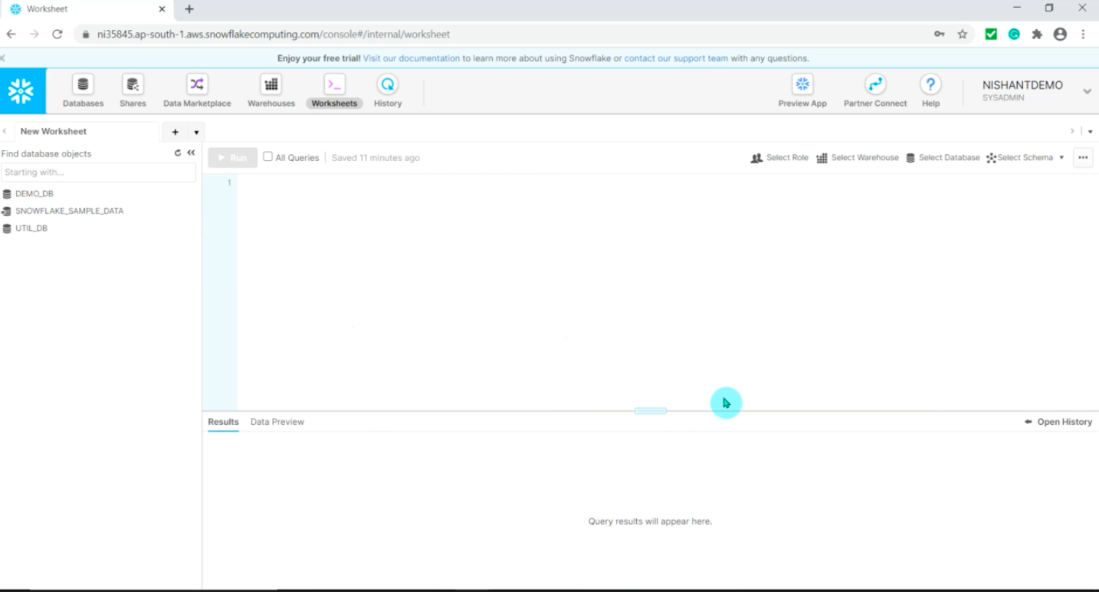
SNOWFLAKE CONSONE

Slide 17
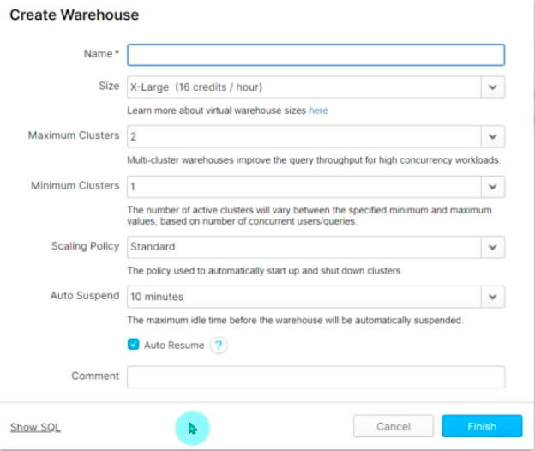
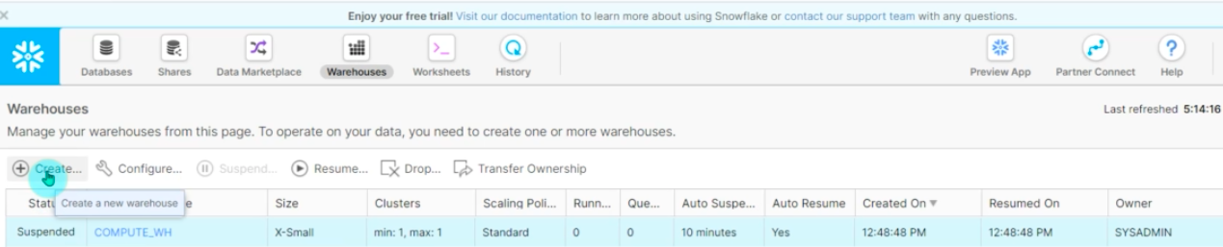
CREATING WAREHOUSE

Slide 18
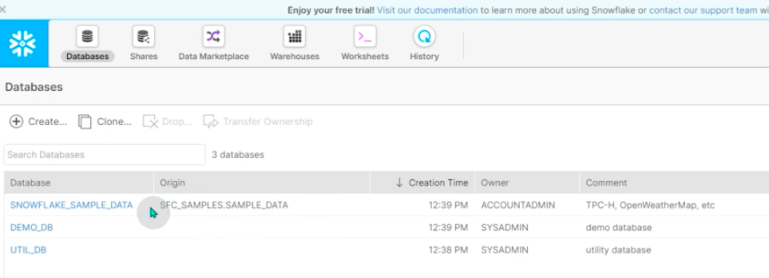
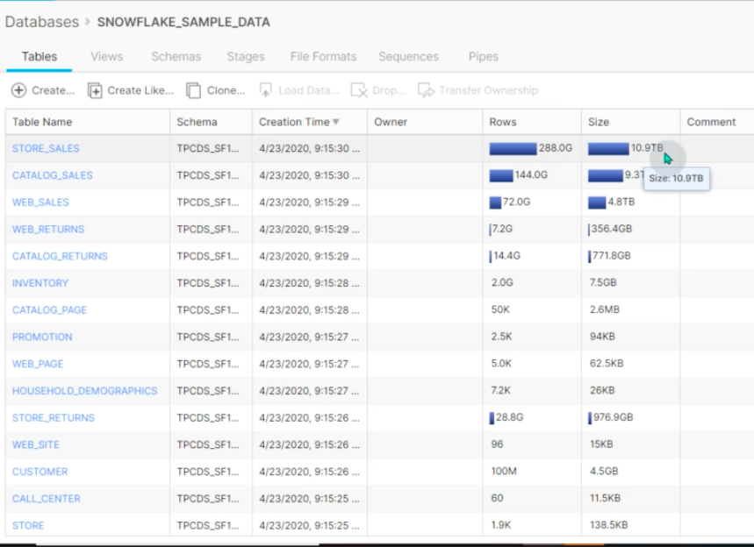
CREATE DATABASE AND TABLES

Slide 19
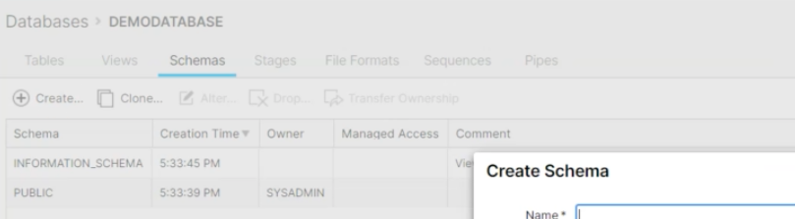
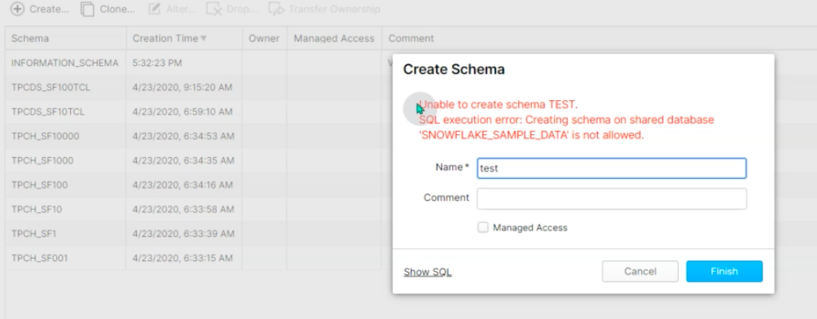
CREATE SCHEMAS

Slide 20
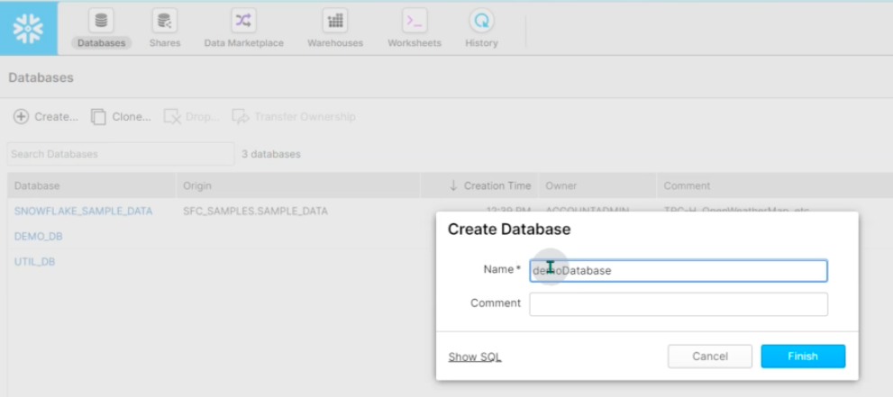
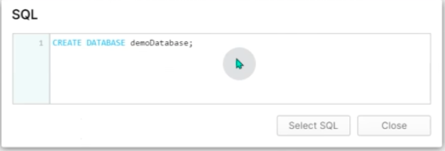
CREATE DATABASE

Slide 21
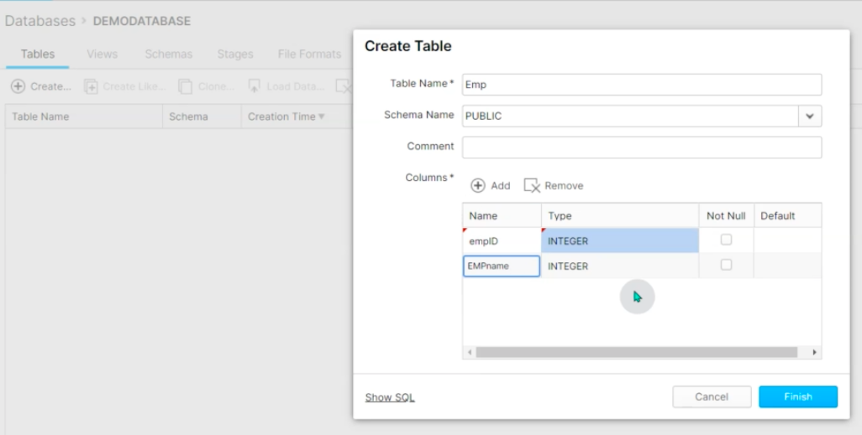
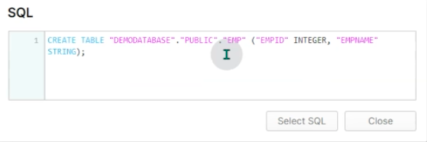
CREATE TABLES

Slide 22
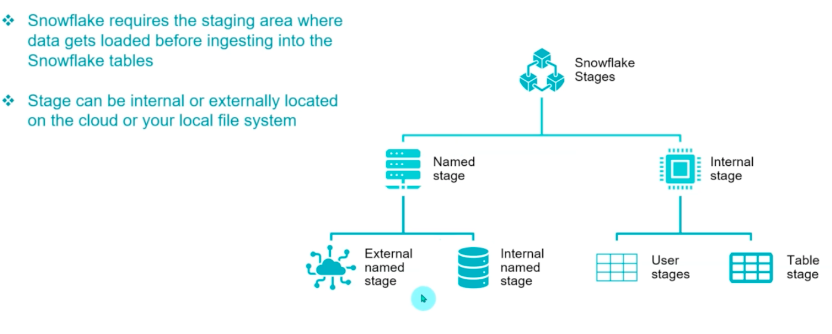
Snowflake Stages

Slide 23
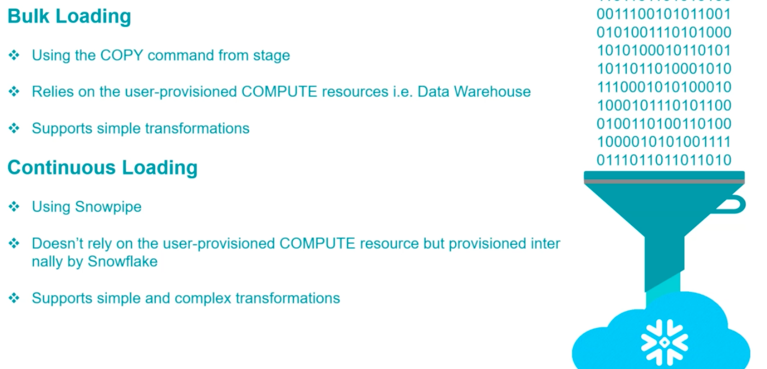
DATA LOAD

Slide 24
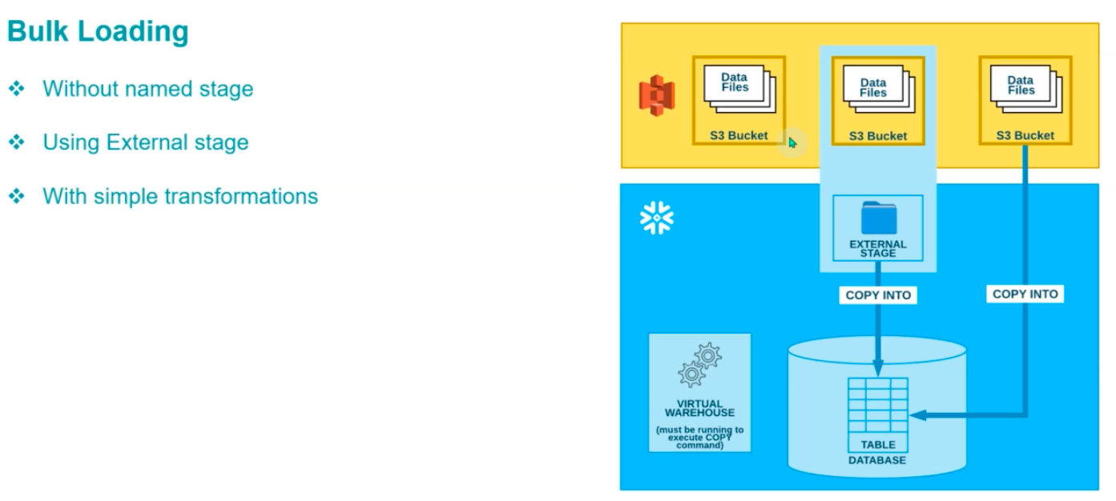
DATA LOAD CONTINUES..

Slide 25
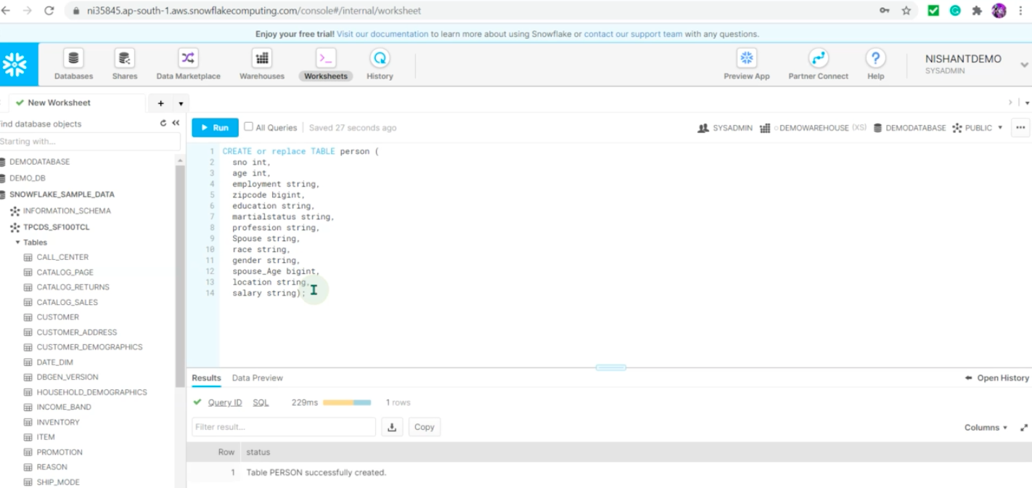
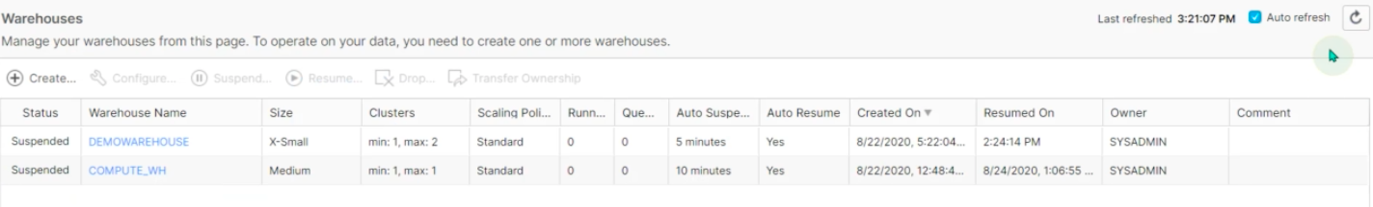
LAB : DATA LOAD

Slide 26
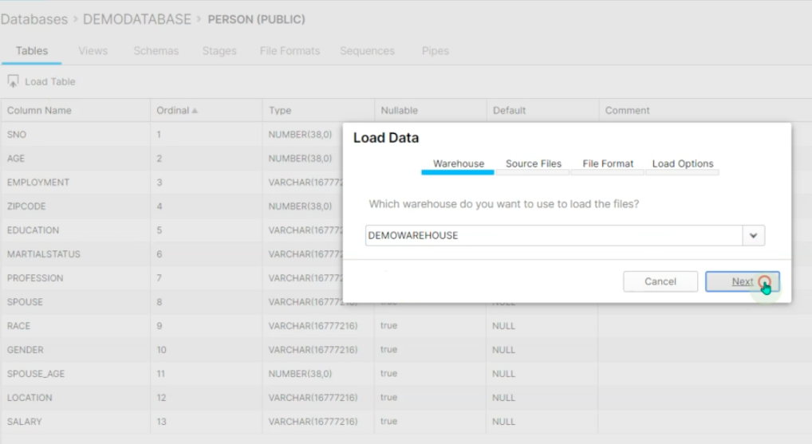
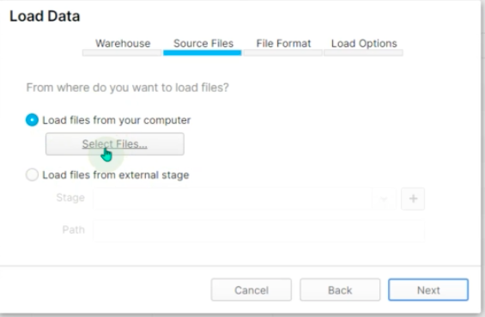
LAB : DATA LOAD

Slide 27
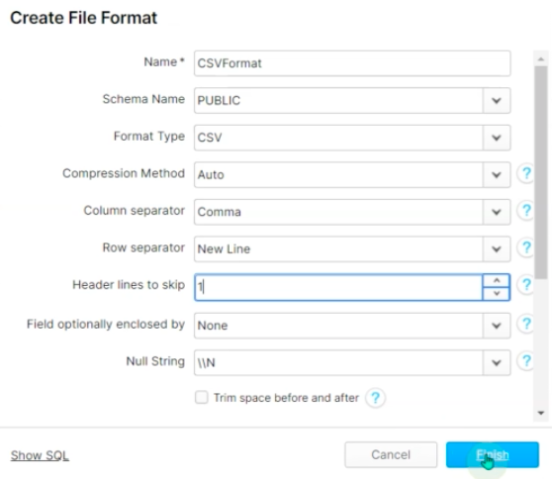
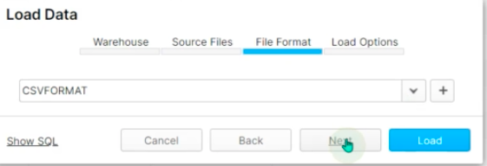
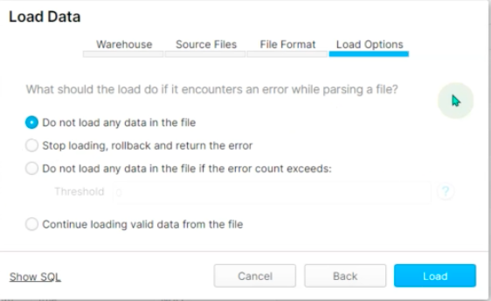
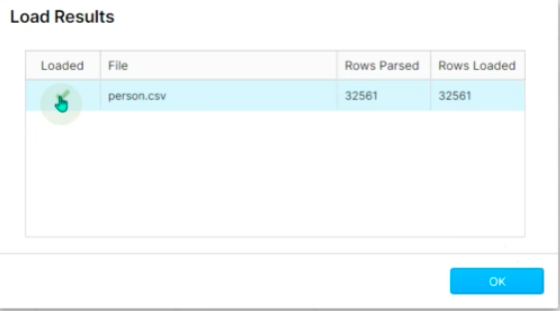
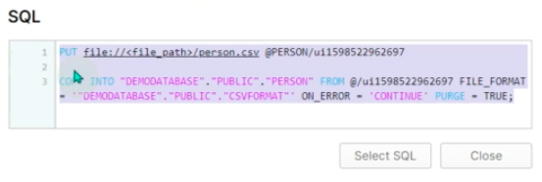
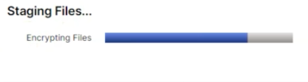
LAB : DATA LOAD

Slide 28
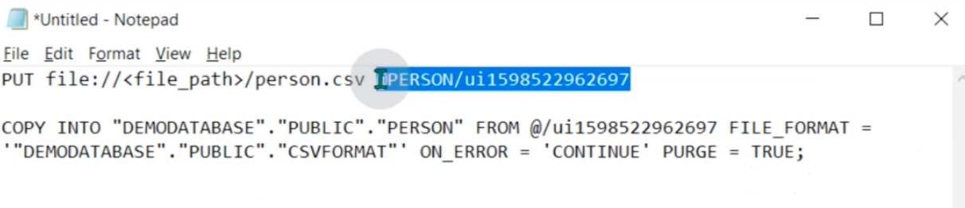
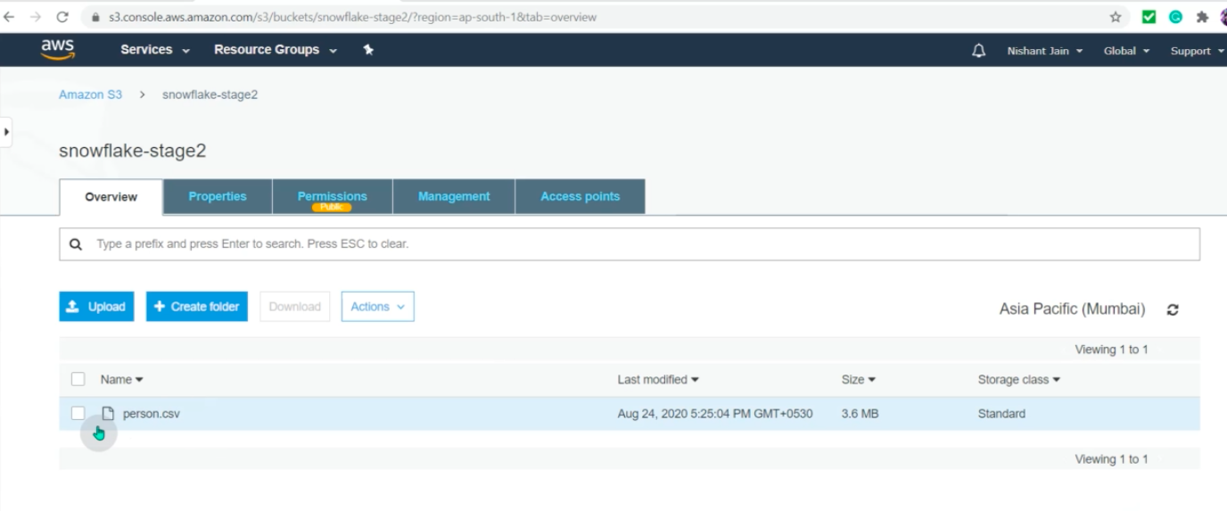
BULK DATA LOAD : PART II

Slide 29
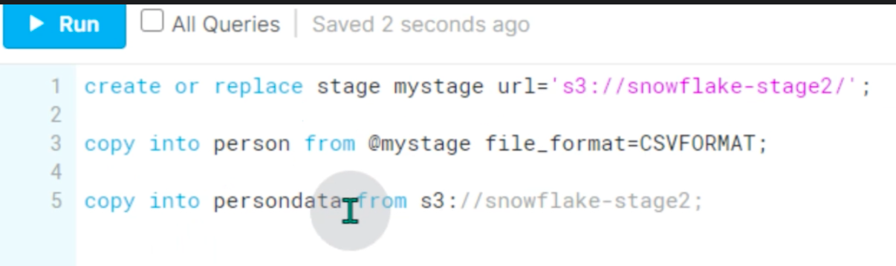
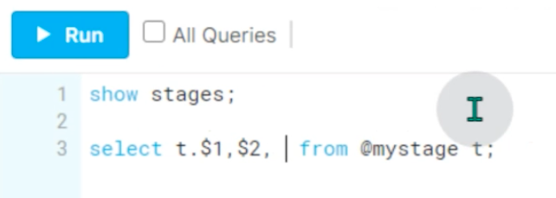
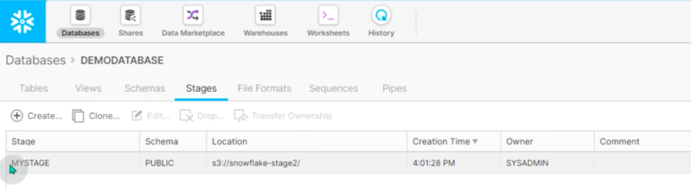
BULK DATA LOAD : PART II

Slide 30
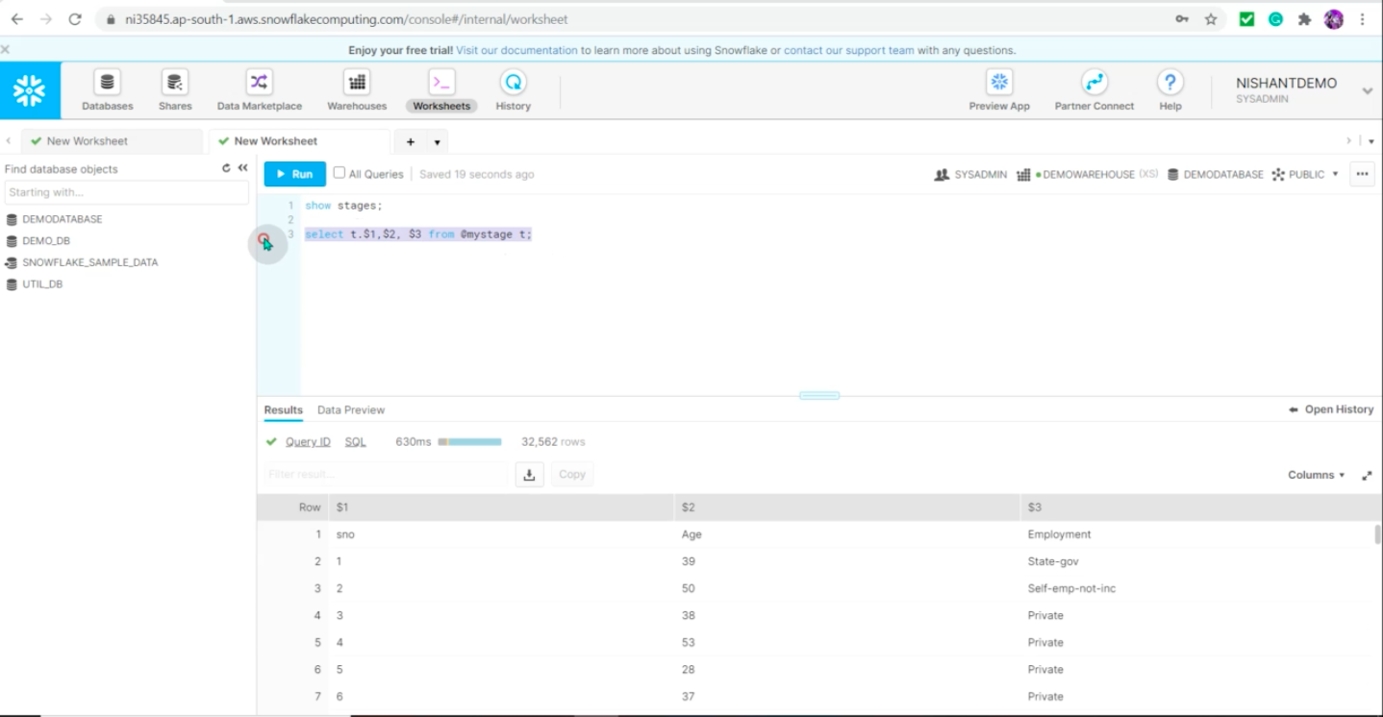
BULK DATA LOAD : PART II

Slide 31
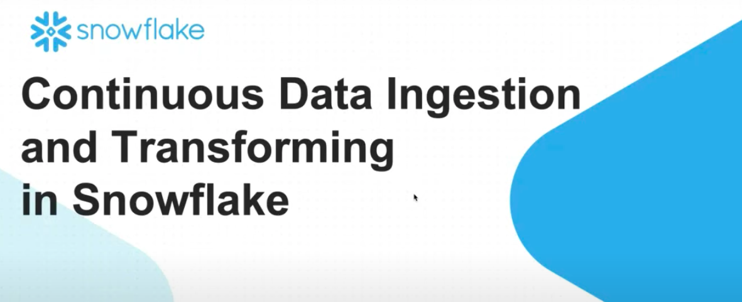
Continuous Data Ingestion and Transforming In Snowflake

Slide 32
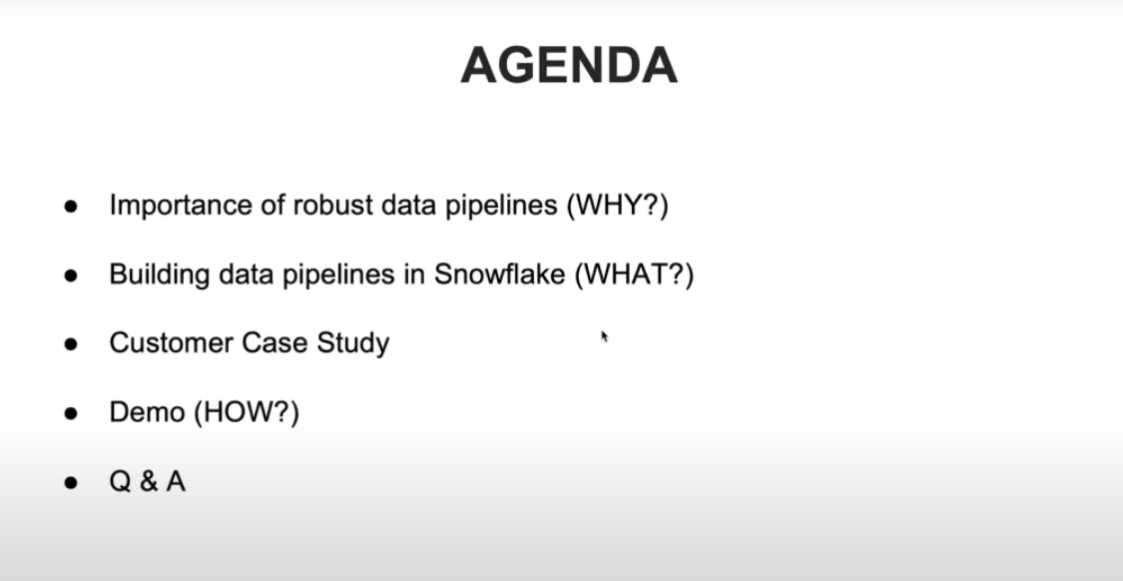
Continuous Data Ingestion and Transforming In Snowflake

Slide 33
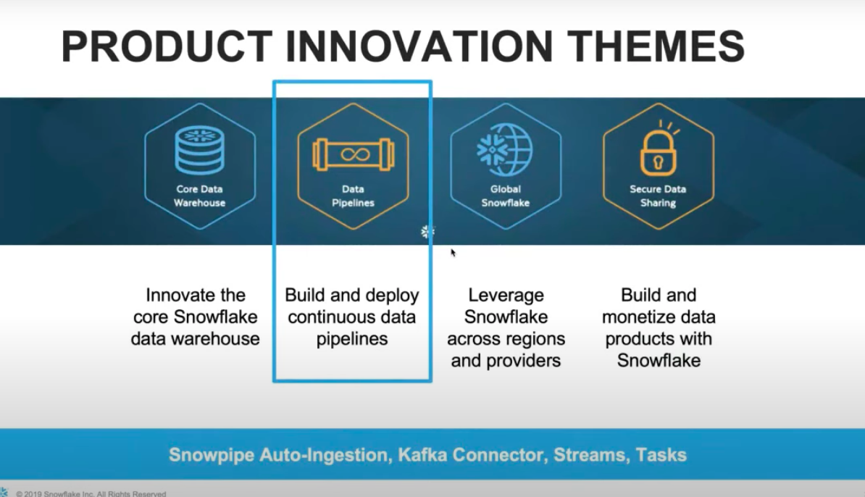
Continuous Data Ingestion and Transforming In Snowflake

Slide 34
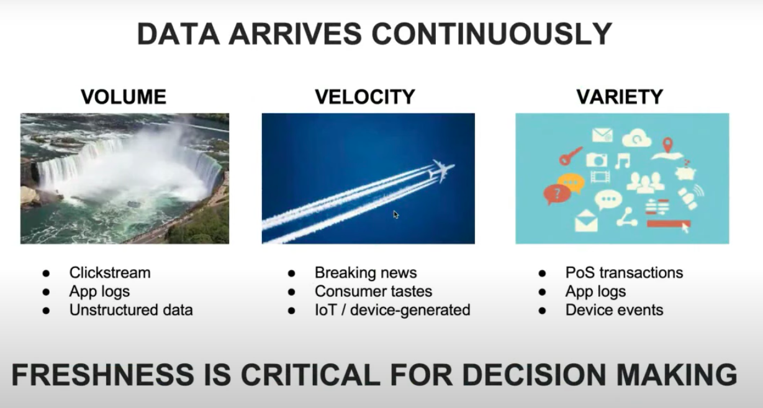
Continuous Data Ingestion and Transforming In Snowflake

Slide 35

Continuous Data Ingestion and Transforming In Snowflake

Slide 36

CONTINUOUS DATA PIPELINES : PROBLEMS ADDRESSED

Slide 37

CONTINUOUS DATA PIPELINES : PROBLEMS ADDRESSED

Slide 38

CONTINUOUS DATA PIPELINES : PROBLEMS ADDRESSED

Slide 39

ARCHITECTURE DIAGRAM

Slide 40

ARCHITECTURE DIAGRAM

Slide 41

SNOWFLAKE CONNECTOR FOR APACHE KAFKA

Slide 42

CHALLENGES WITH KAFKA DATA INGESTION

Slide 43

KAFKA CONNECTOR

Slide 44

SIMPLE AND ROBUST INGESTION

Slide 45

STREAMS & TASKS

Slide 46

TASKS

Slide 47

EVENTS BASED SERVERLESS DATA INGESTION PIPELINE

Slide 48

DEMO STEPS

Slide 49

THANK YOU…!!!

